Slide 1

CREDIT SCORE CARD

Slide 2

INTRODUCTION
PROBLEM STATEMENT:
Help financial institutions find credit worthiness of a customer.
OBJECTIVE:
To develop a credit scoring model to predict loan default probability.

Slide 3
METHODOLOGY
Approach:
Exploratory Data Analysis (EDA): Picked insights on particular columns to have a feel of the data.
Feature Selection: Using domain knowledge selected features that were most important to the objective of the project.
Model Development: Classification models, Logistic Regression, Random Forest Classifier, XG Boost from Scikit Learn’s library.
Model performance: Scikit Learn’s evaluation metrics, ROC-AUC curve.
Tools Used: Scikit Learn, Numpy, Pandas, Google Colab.

Slide 4
DATA OVERVIEW
DATA BACKGROUND:
Source: The dataset is obtained from https://www.kaggle.com/datasets .
Features: Dataset has 24 columns but key columns include Number of loans, Outstanding debt, Credit history age, Credit score, Annual income.
Data Size: 50000 rows and 24 columns.
Preprocessing:
Filled missing data using mean imputation.
Used Scikit Learn for feature engineering.
Cleaned data in columns.

Slide 5
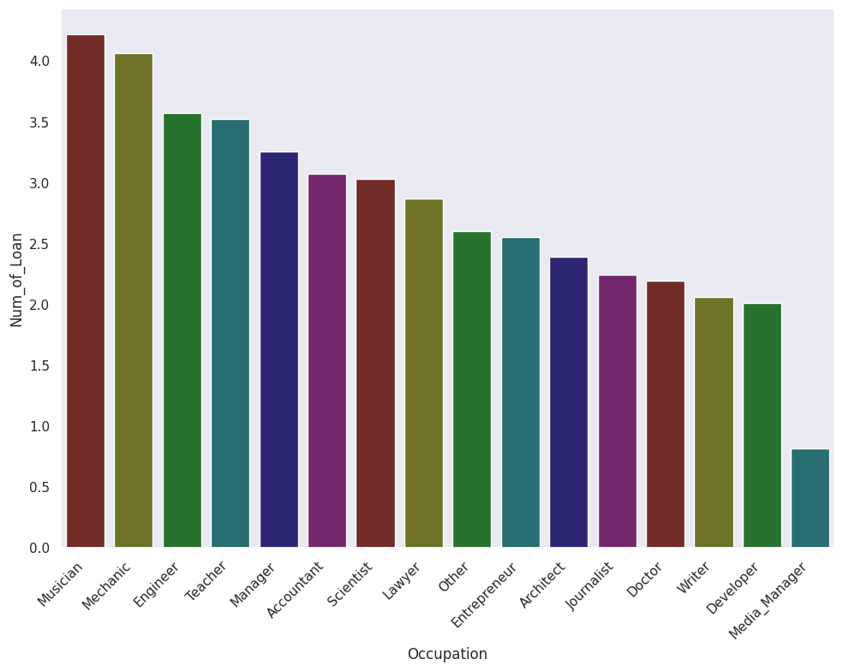
DATA OVERVIEW
Occupation Vs Number of Loans
Occupation Vs Number of Loans
The graph show the customers grouped according to occupation and the average number of loans for each occupation.

Slide 6
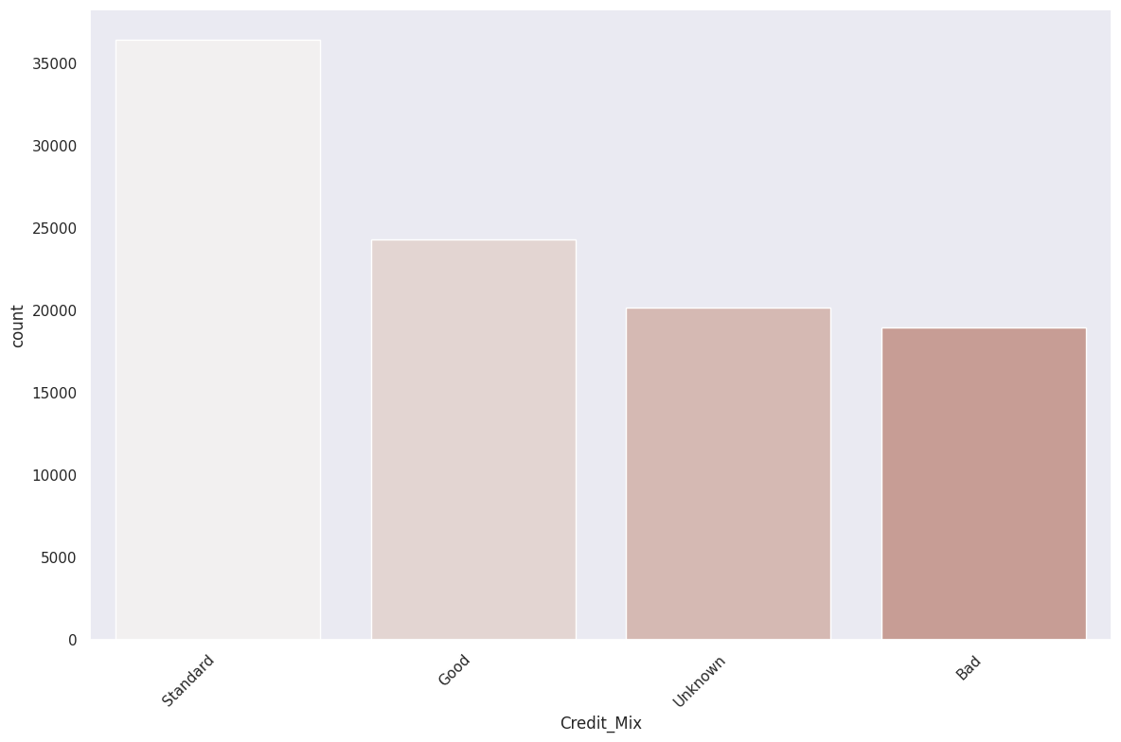
DATA OVERVIEW
Credit Mix Counts
Credit Mix counts
Despite having a large number of customers who cannot be accounted for not being in either category most of them have a fairly stable credit behaviour.

Slide 7
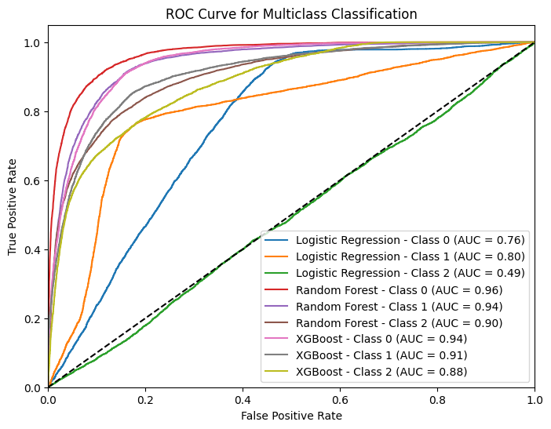
MODEL PERFORMANCE
Random Forest: Best performing with an accuracy score of 80.3%.
XGBoost: Second best accuracy 76.6%.
Logistic Regression: Worst performing model 55.6%.

Slide 8
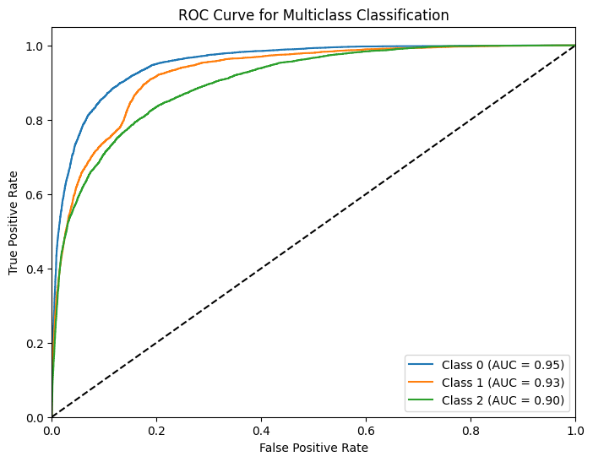
MODEL PERFORMANCE
AUC-ROC Curve:
The model performed well above 0.9 for all 3 classes.
Confusion Matrix:
Confusion Matrix: [[[6514 91 476]
[ 720 5785 595]
[1101 1213 4911]]

Slide 9
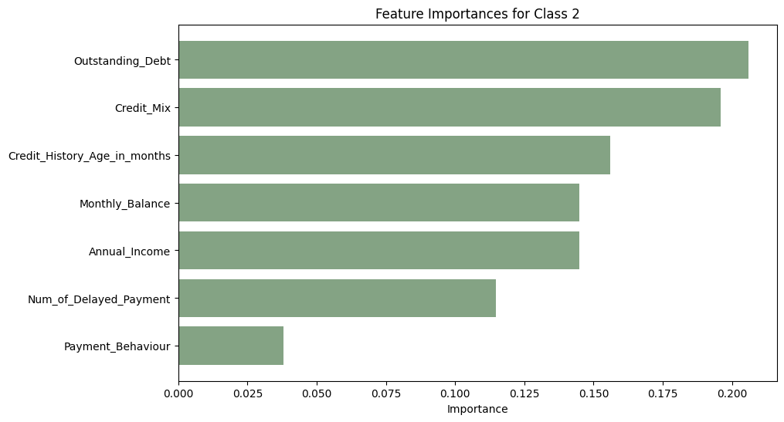
KEY INSIGHTS
Particular features contributed immensely to why a customer is most likely to be categorised as Standard, Poor or Good:
Outstanding debt
Credit_Mix
Credit_History
Monthly_balance
Annual_Income

Slide 10
CONCLUSION
The model will significantly help financial institutions on credit scoring and avoid pitfalls of loan defaulting, by factually selecting creditors.

